Slide 1
Big Mountain Resort

Slide 2
Problem Statement
Weekday and weekend prices are underpriced based on the natural features and infrastructure our guest experience provides.
We need to find out what features most greatly affect ticket price
We want to know how much of a ticket price increase would the market support based on our features and infrastructure.
We need to offset the increase in operational cost from the new chair lift investment.
Provide Cost cutting measures
Provide Revenue Boosting measures

Slide 3
Recommendations and Key Findings
Key features that affect ticket price are: Vertical Drop, Snow Making acreage, total chairs, fast Quad chairs, number of runs, longest run length, trams, and skiable terrain.
Big Mountain among the top resorts in many of these key features. The model suggests the market would support a ticket price of $95.87. An increase of $15.87 on the current ticket price
To offset operational cost increase, ticket price would need to be increased by $0.88/ticket.
Best cost cutting measure: experiment with closing 1, 2, or 5 runs and the effect on operational cost
Best revenue boosting measure: Increase vertical drop by 150ft, and build new chair lift to reach it. This would support a $1.99 ticket price increase.

Slide 4
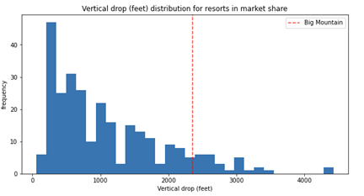
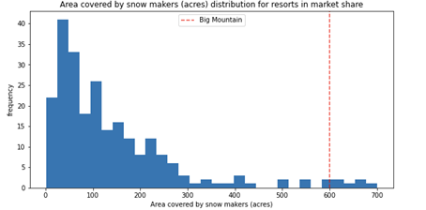
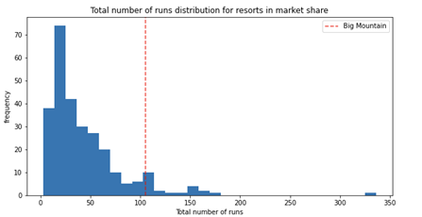
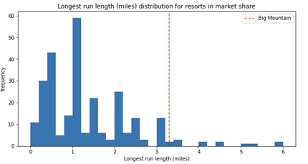
Modeling Results and ANalysis

Slide 5
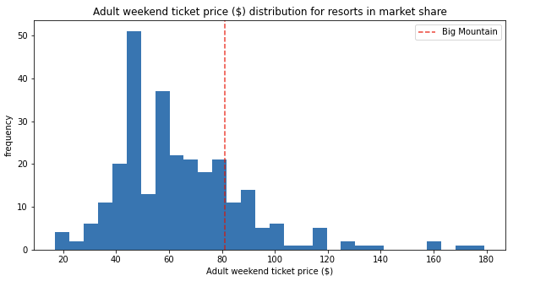
Modeling Results and Analysis
The previous slide showed Big Mountain’s position for key features
The current slide shows our position for ticket price.
Despite offering a premium experience, our prices are lower than would be expected, which supports a significant increase in ticket price.

Slide 6
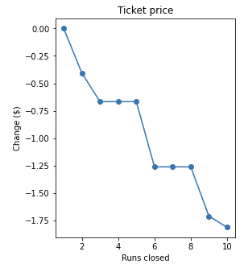
Modeling Results and Analysis
Possible cost cutting measure: Close down 1, 2 or 5 runs.
While you do lose value as far as ticket price goes, that may be offset by a decrease in operational cost. Big Mountain can experiment by closing different numbers of runs. Closing 1 or 2 runs means less ticket value loss, but our model suggested that there is no difference in ticket price between closing 3, 4 or 5 runs, which may lead to a lower operational cost.
Possible revenue boosting measure: Increase vertical drop
Our model suggests that Big Mountain can increase its vertical drop by 150 and build a new chair lift to service the extra height, and that would support a ticket price increase of $1.99.

Slide 7
Summary and Conclusion
Increasing ticket price is a no-brainer. In order to offset the increase in operational cost from the new chair lift, Big Mountain only has to raise ticket prices by $0.88.
The model suggests that to bring the ticket price in line with the features and infrastructure that Big Mountain can offer could mean a ticket price increase of $15.87. Which could lead to an increase in revenue of almost $28 million.
Using incremental increases in ticket prices over the next few years could allow Big Mountain to reach a ticket price value that matches the guest experience provided without giving customers sticker shock with one big switch and would allow Big Mountain to experiment with other cost-saving measures and revenue boosting measures to implement in the future.

